Slide 1
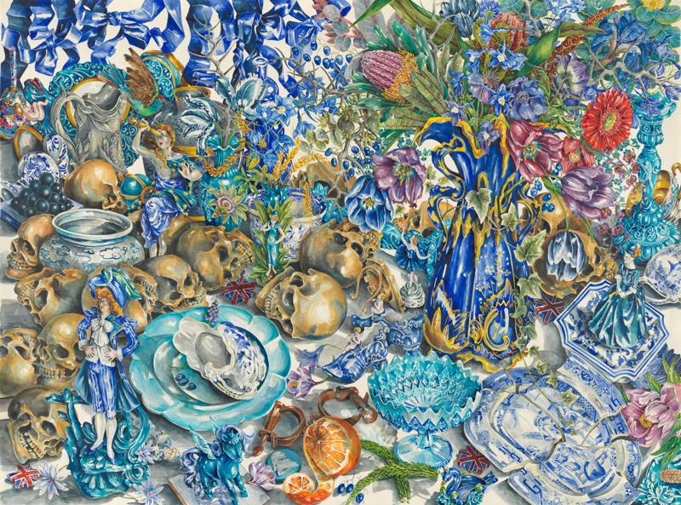
Ex de Medici: Power, Politics & Precision
Exploring the Work of
Ex de Medici
in Contemporary Art

Slide 2
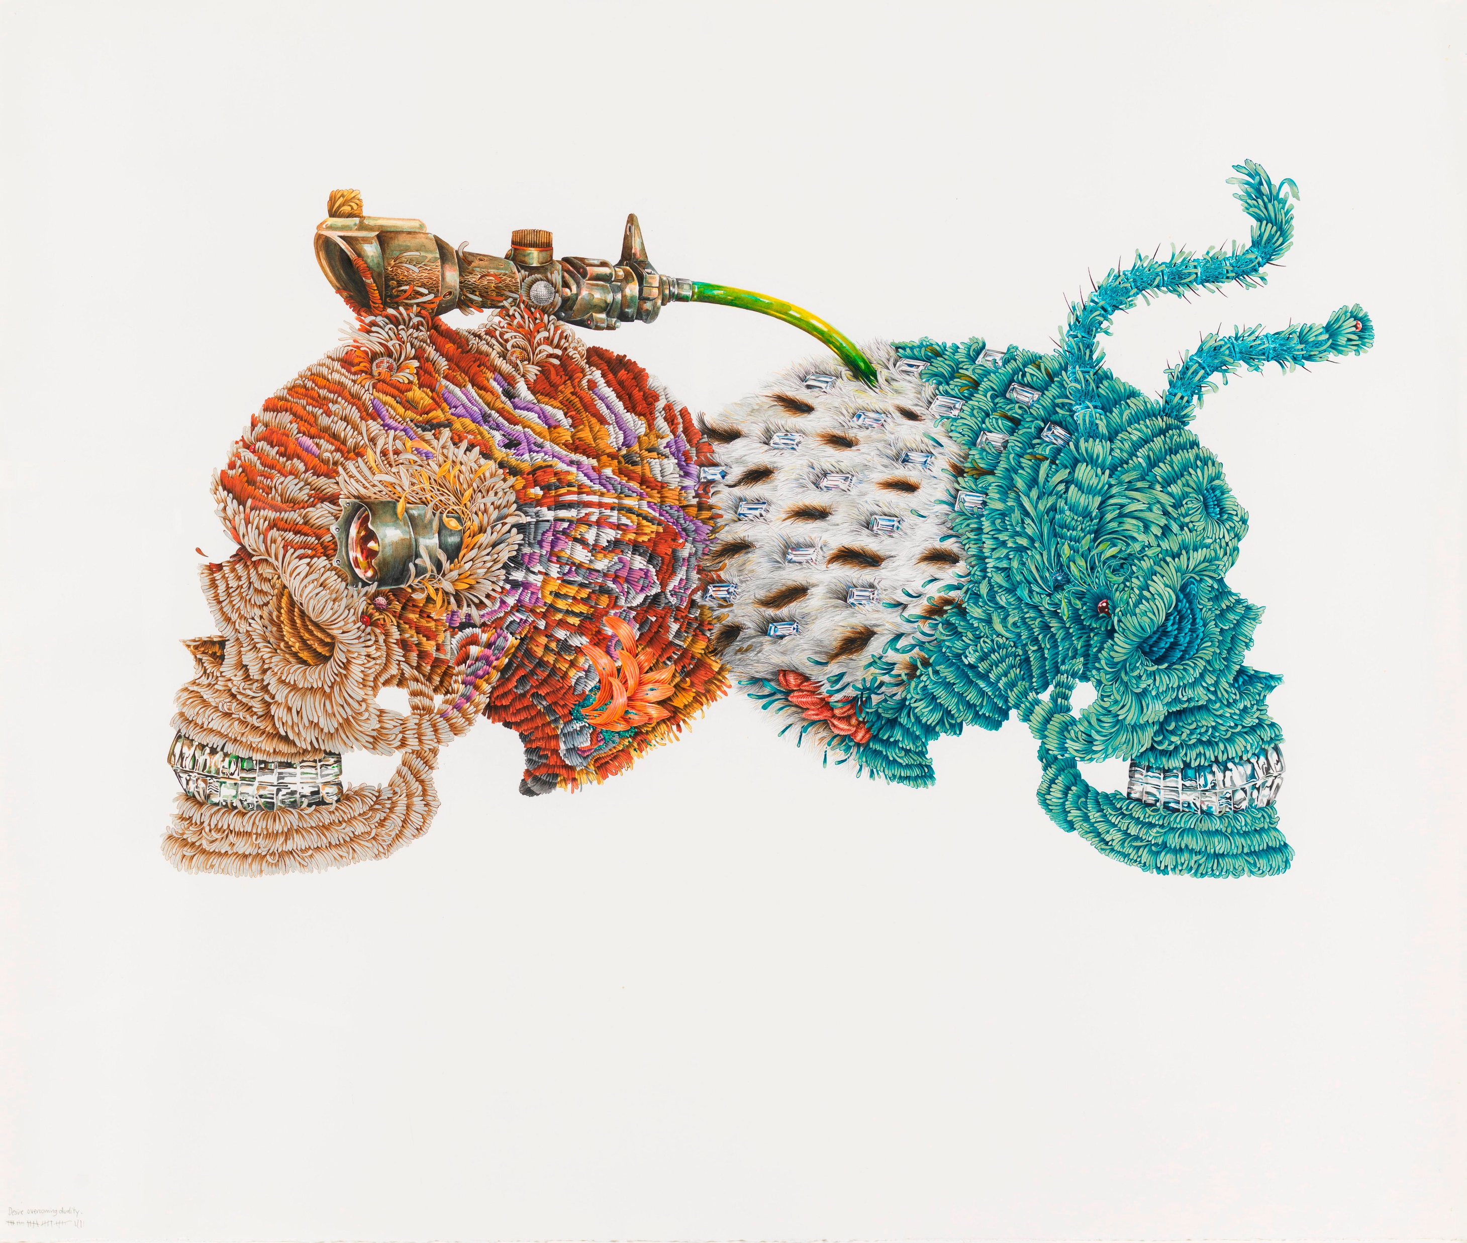
Who is Ex de Medici?
Australian contemporary artist known for hyper-detailed watercolors.
Former tattoo artist, influencing her intricate style.
Critiques power, war, surveillance, and capitalism.
Uses contrast between beauty and brutality.
Artist’s Style & Techniques
Hyperrealistic watercolor with fine details. Trompe-l'œil illusion for realism.
Juxtaposition of beauty & violence (flowers with guns/skulls).
Symbolism: Skulls (mortality), weaponry (violence), insects (decay).

Slide 3
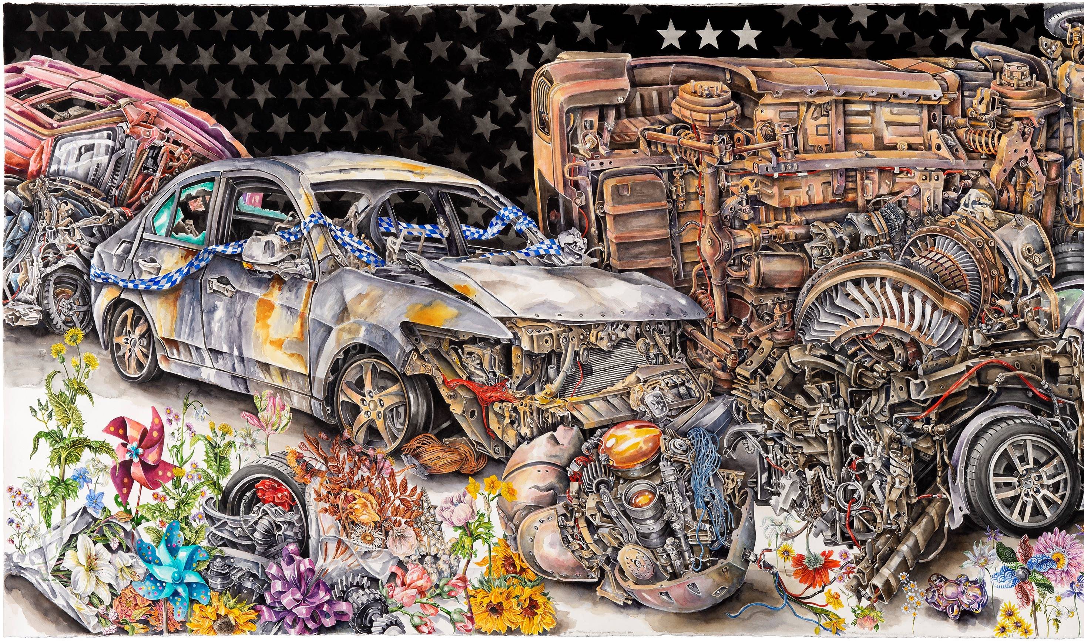
Artwork Analysis: The Wreckers (2017)
Features guns, butterflies, and skulls.
Critique of war, destruction, and environmental damage.
Vivid colors contrast with sinister themes.

Slide 4
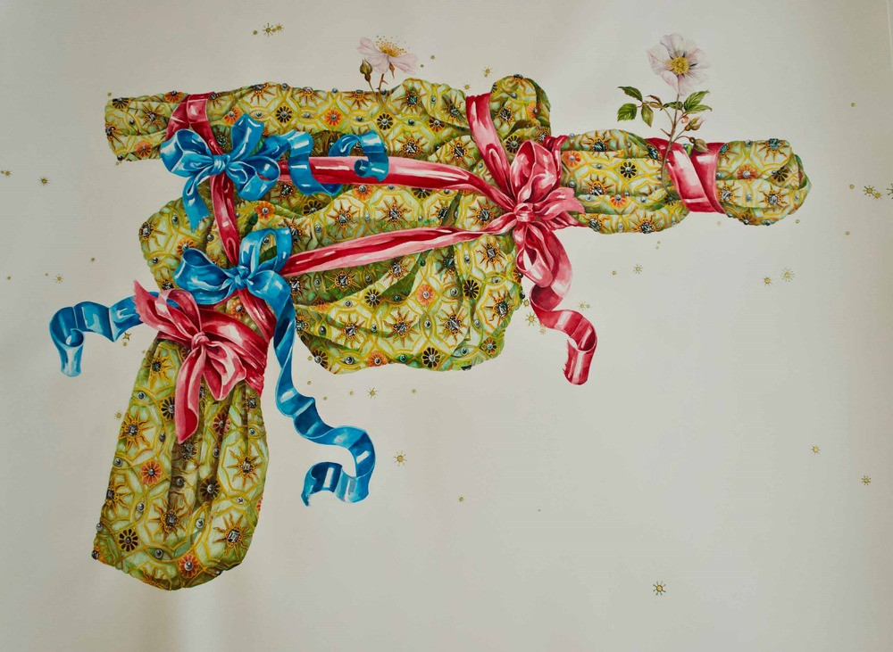
Artwork Analysis: Guns & Flowers (2004)
Depicts handguns surrounded by floral arrangements.
Symbolizes contradiction between war & peace, power & fragility.

Slide 5
Analysing an Artwork
Analyze a selected ex de Medici artwork using these four contexts:
1.Contemporary: What global issues does it relate to?
2. Cultural: What symbols and references are used?
3. Formal: How are elements/principles of art applied?
4. Personal: How does Ex de Medici’s background influence the work?

Slide 6
Reflection
How do her artworks challenge power and violence?
Do artists have a responsibility to address political issues?
What symbols would you use in an artwork about power?

